Slide 1
Citi Bike 2013 comparison to 2018
File created on: 4/30/2019 3:19:33 PM

Slide 2
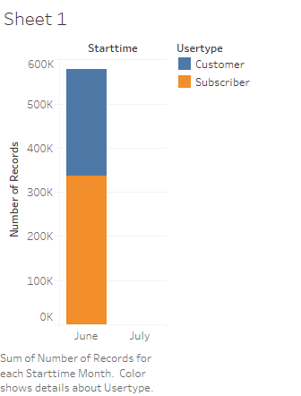

Slide 3


Slide 4


Slide 5


Slide 6


Slide 7
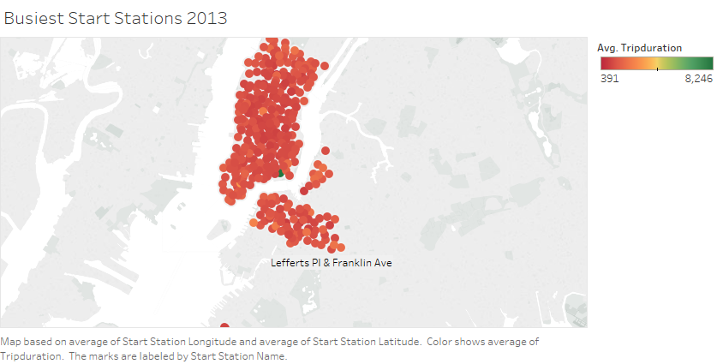

Slide 8
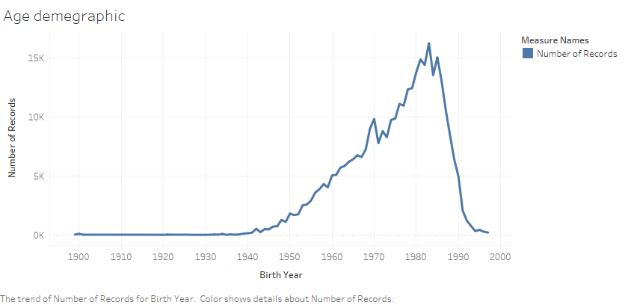

Slide 9
